Slide 1

PREDICTING MOVIE GROSSES
BY: ALEK SANCHEZ

Slide 2
Overview:
Objective:
To predict a film’s total Domestic Gross, given it’s features
Data Features:
Genre, Rating, Distributor, Release Date, Opening Weekend Length, 3D/IMAX Format, Release Pattern
Opening Weekend Gross, Runtime, Rotten Tomato Score, CinemaScore
13,000+ rows of data From 2019 to 1937

Slide 3
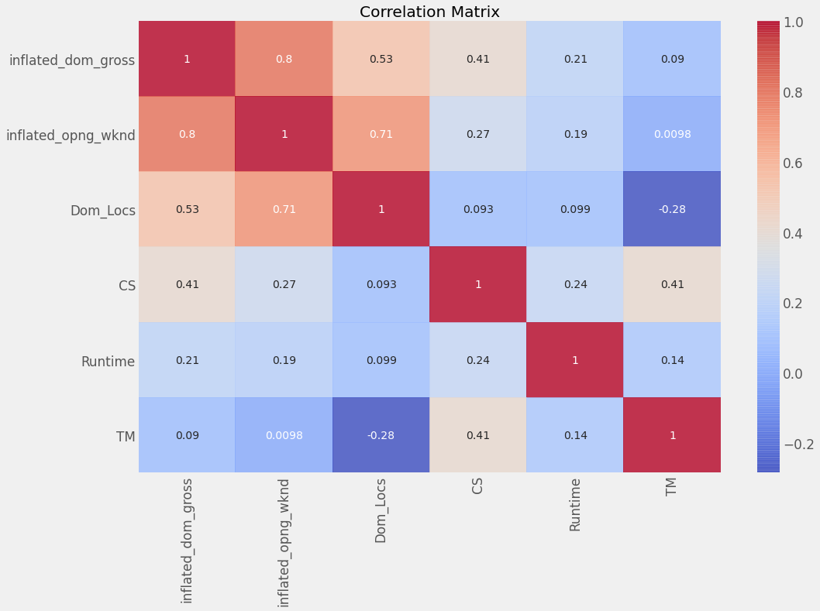
EDA: Correlation Matrix of Features

Slide 4
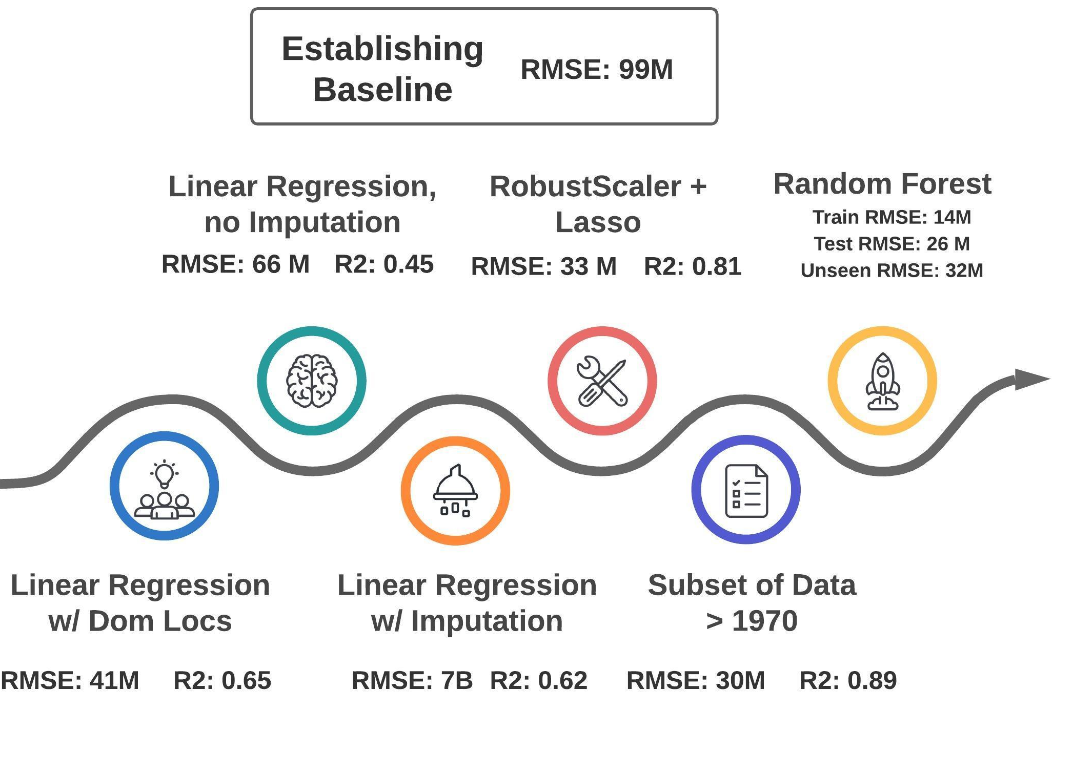
Model Iteration Process

Slide 5
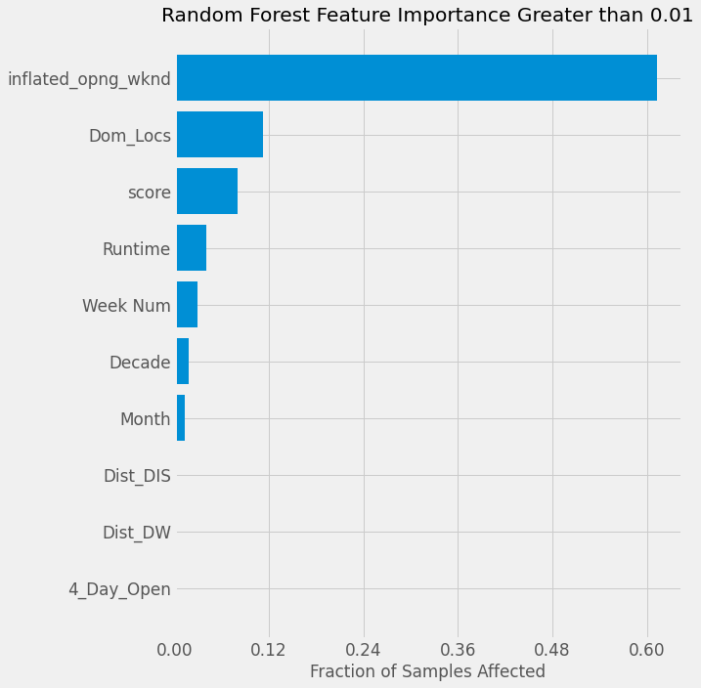
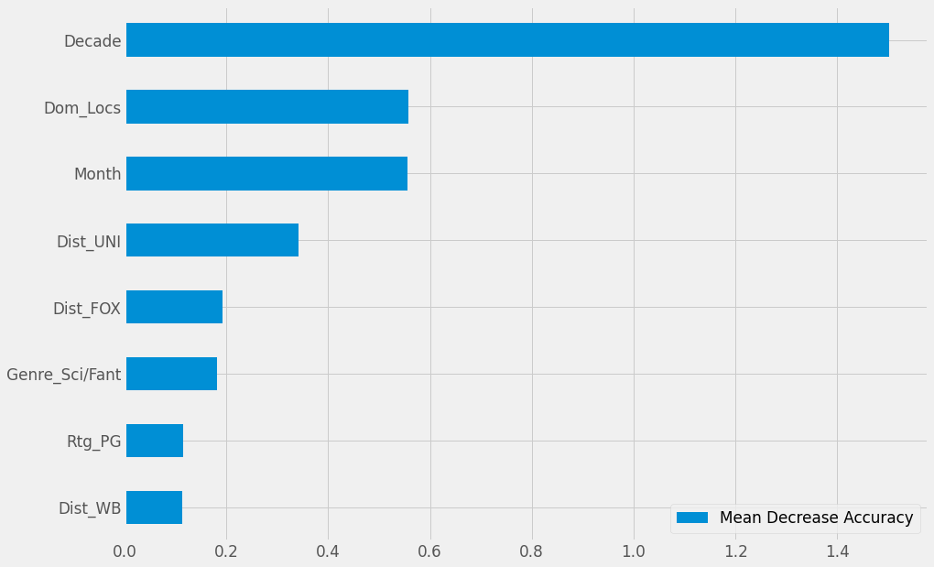
Random Forest Feature Importance
Random Forest Feature Importance: Mean Decrease Accuracy

Slide 6

Next Steps
Add more numeric rich data (other types of scoring metrics, audience demographic data, etc.)
Continue expanding more thorough Grid Searching

Slide 7

ANY QUESTIONS?

Slide 8
APPENDIX

Slide 9
EDA: Mean and Standard Deviation of Numeric Values
 | Dom Gross | Dom Locs | Opng Wknd | Runtime | TM | CS | Inflated Dom Gross | Inflated Opng Wknd
Mean | 23,726,358.06 | 887.36 | 6,335,375.60 | 104.91 | 57.27 | 85.02 | 36,469,731.63 | 8,451,958.08
STD | 52,844,072.79 | 1,206.61 | 15,988,514.72 | 19.65 | 27.88 | 7.40 | 85,959,264.59 | 19,045,083.79

Slide 10
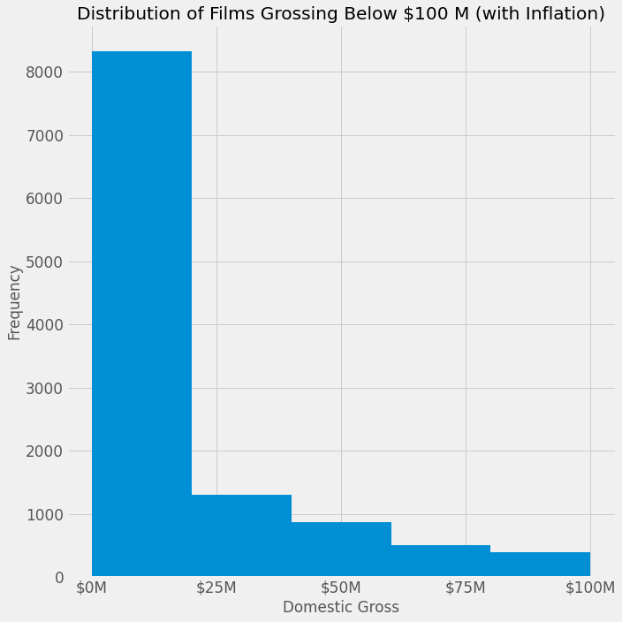
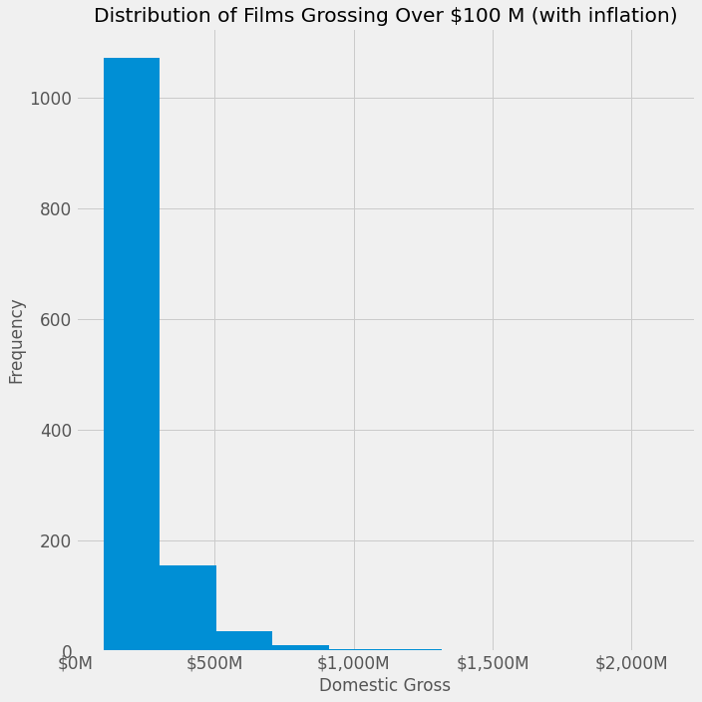
EDA: Distribution of Films by Domestic Gross (with Inflation)

Slide 11
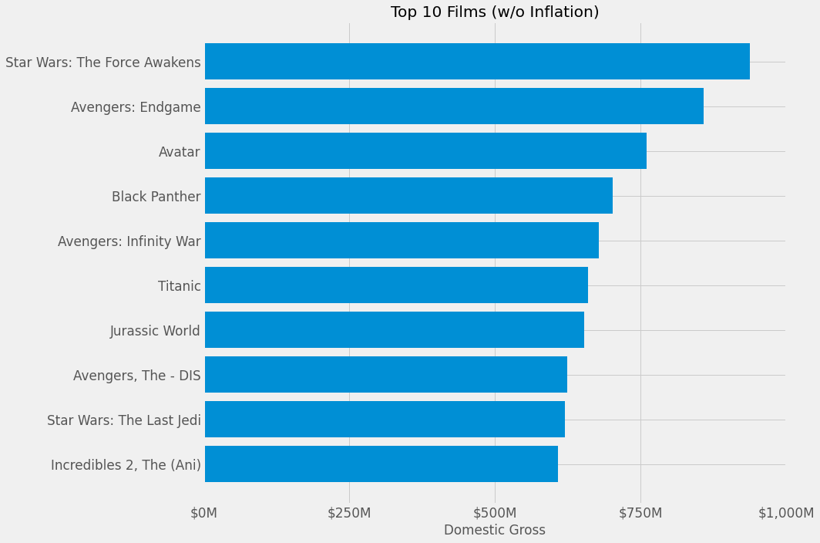
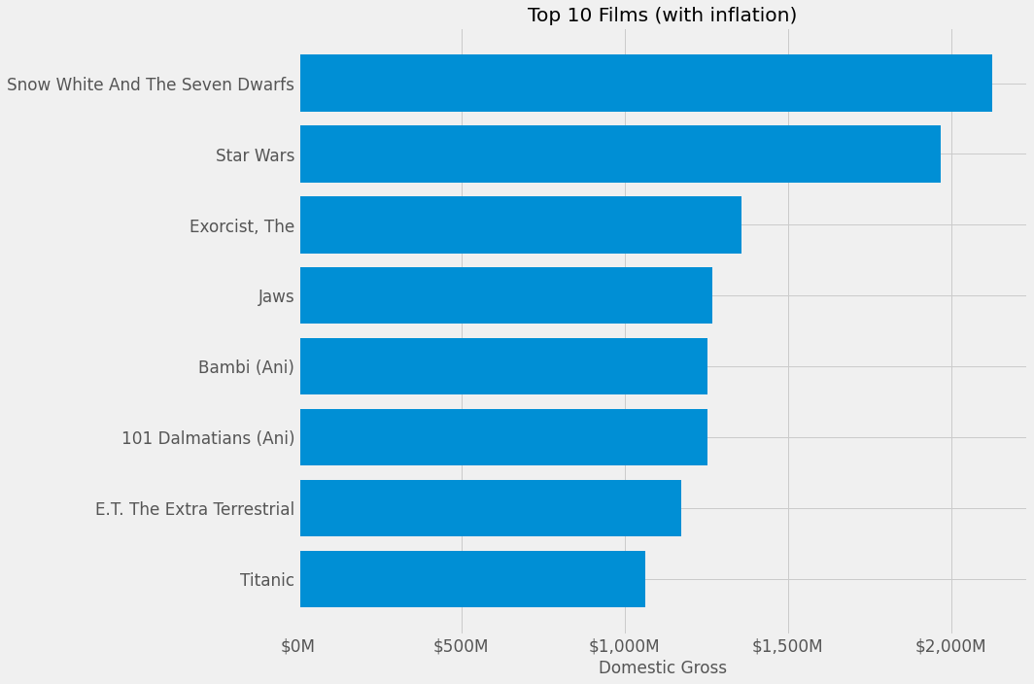
EDA: Top 10 Films (with and without Inflation)

Slide 12
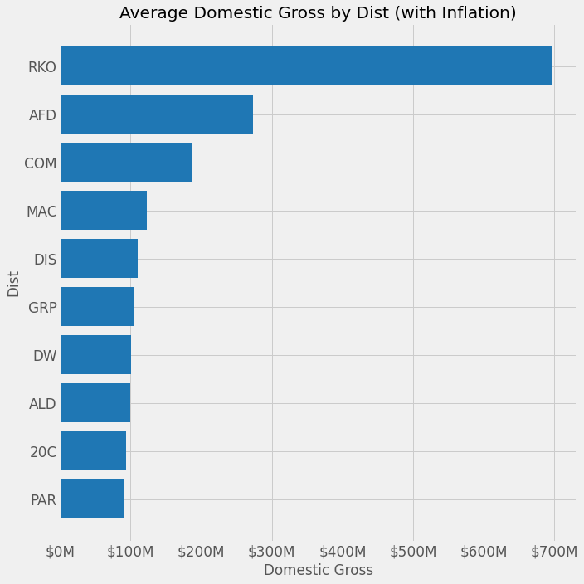

Slide 13
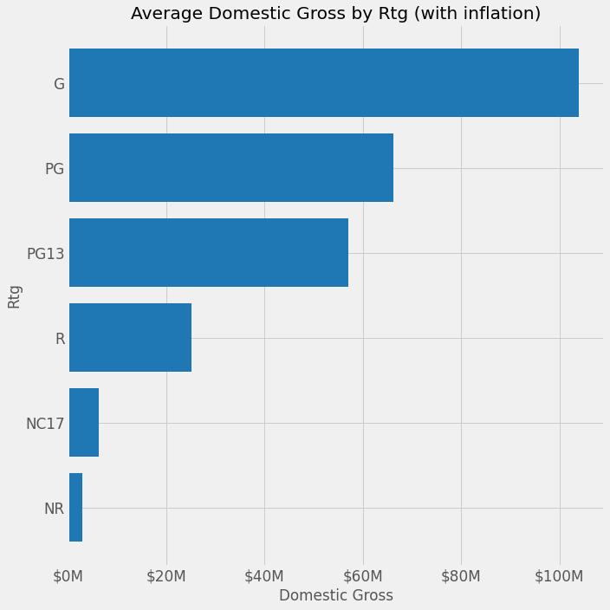

Slide 14
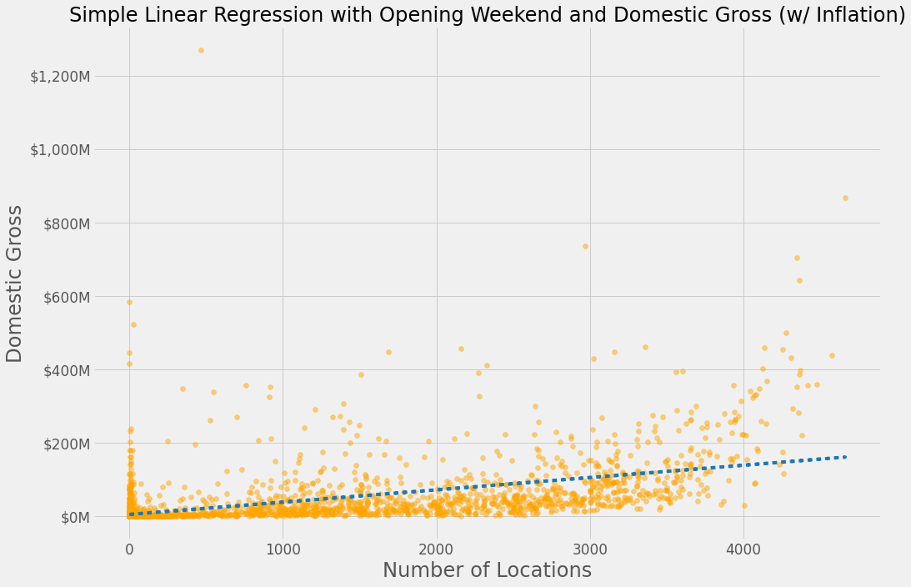
Simple Linear Regression with Domestic Locations and Domestic Gross (w/ inflation)

Slide 15
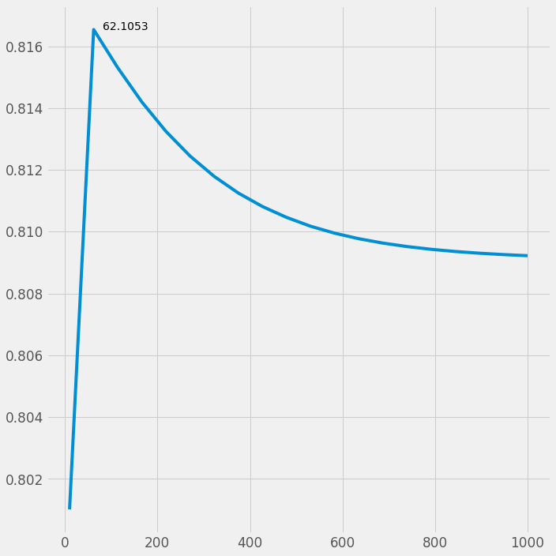
Appendix: Optimal Number of Iterations for Lasso Regression

Slide 16
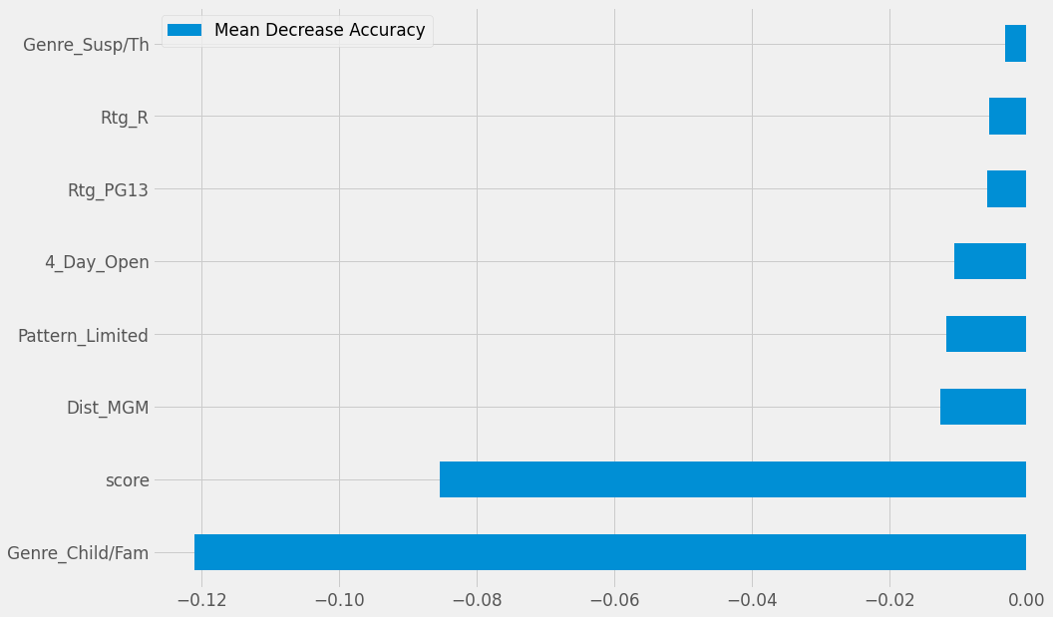
Random Forest Feature Importance: Mean Decrease Accuracy - Negative Values

